Slide 1
Project (Web Technology II)
Name of Team Members
Sahijpal Kaur Saran(C0737804)
Amandeep Kaur Chahal(C0736019)
Ramanpreet Kaur(C0723062)

Slide 2

Bag Lovers

Slide 3
In this app we have used
Jquery
Jquery mobile
Java script
Sqllite
Local storage

Slide 4
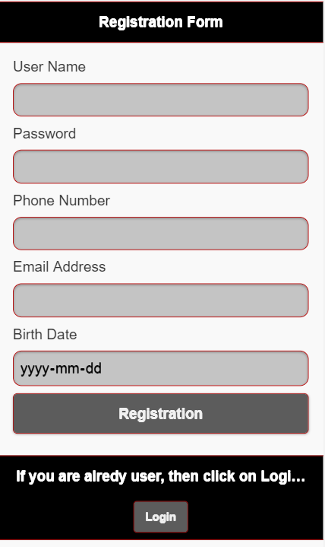
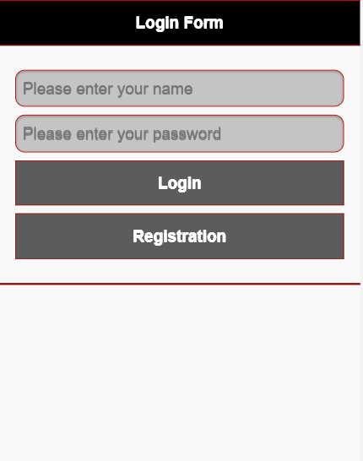
Registration Form

Slide 5
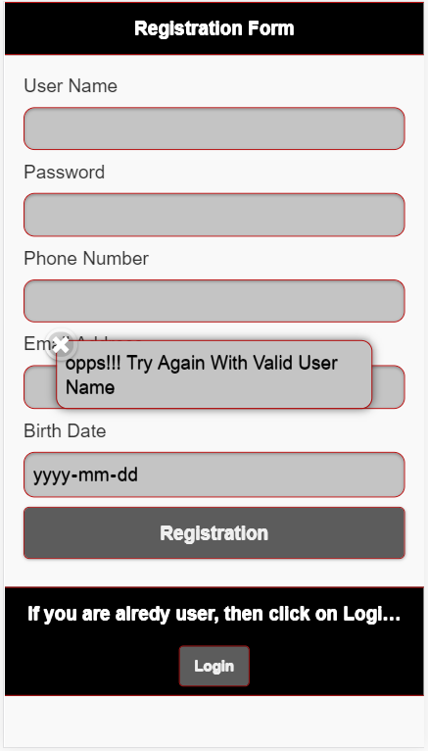

Slide 6
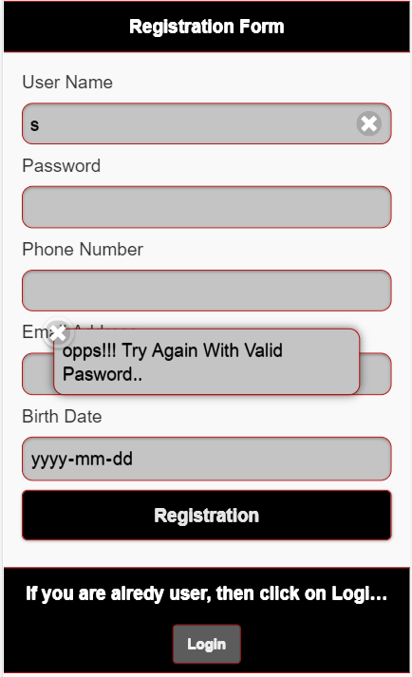
Validation-Error Message

Slide 7
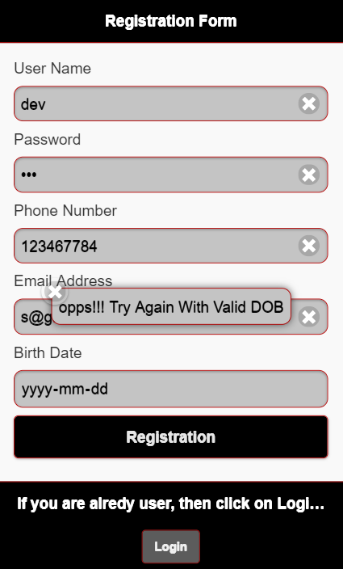
Validation-Error Message

Slide 8
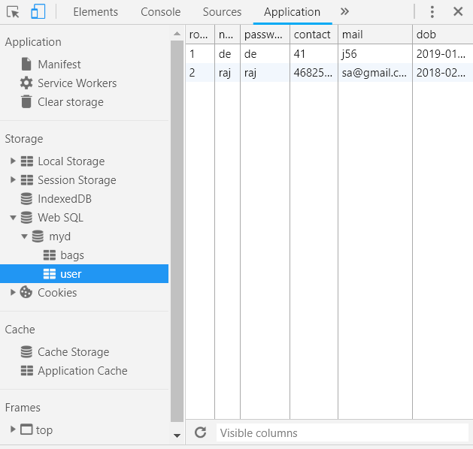
Database

Slide 9
Welcome Page

Slide 10
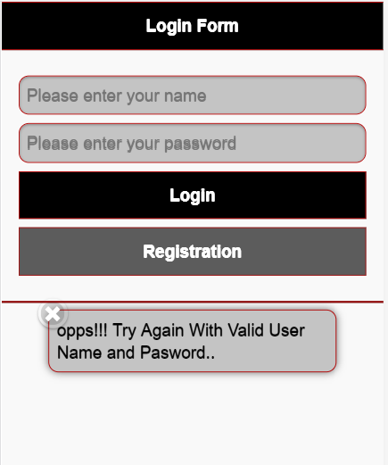

Slide 11
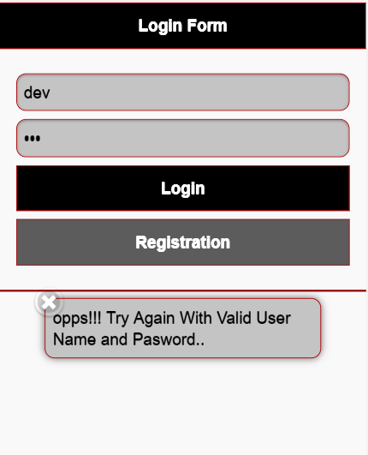
Error Message

Slide 12
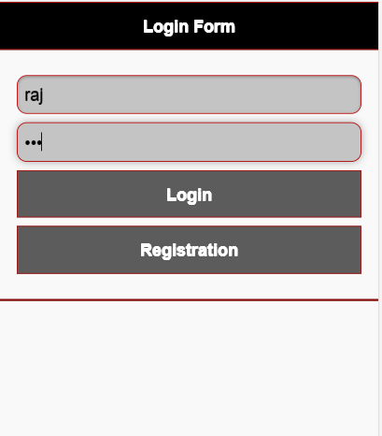

Slide 13
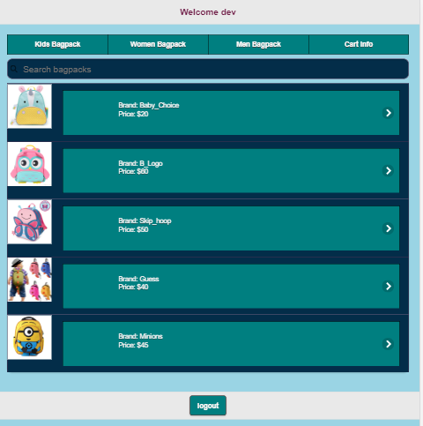
Main Page

Slide 14
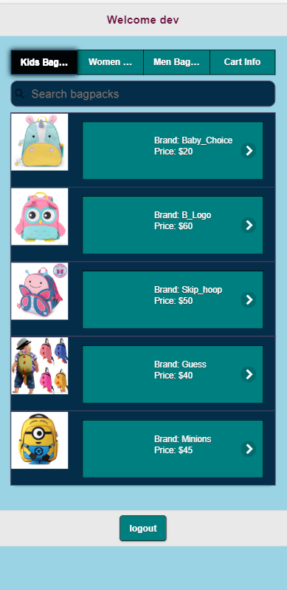
Add to Cart

Slide 15
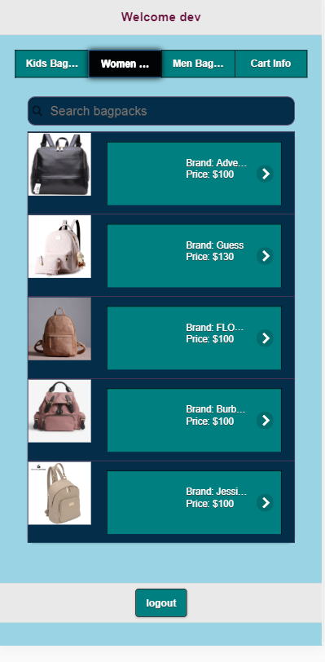
Add to Cart

Slide 16
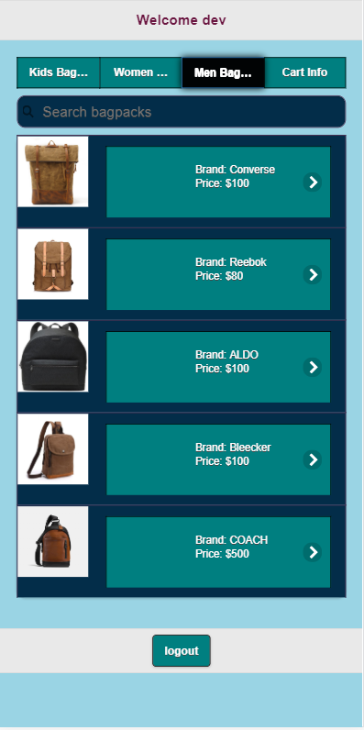
Add to Cart

Slide 17

Cart Information

Slide 18
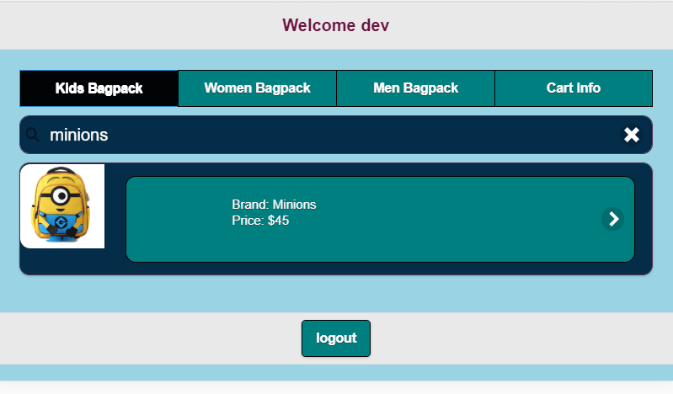
Cart Information

Slide 19
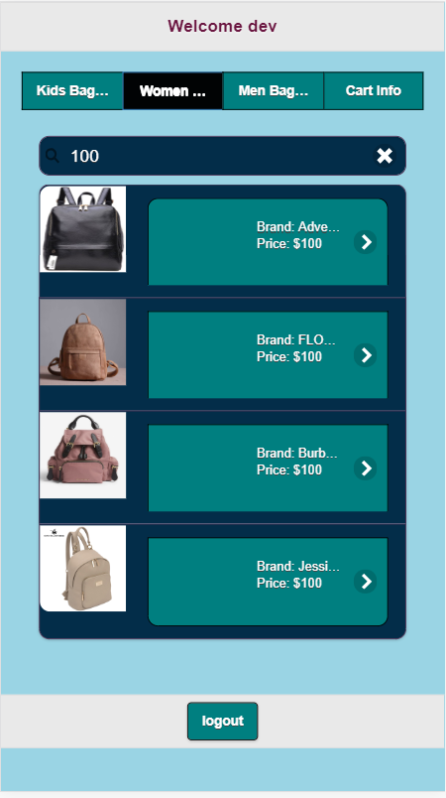

Slide 20
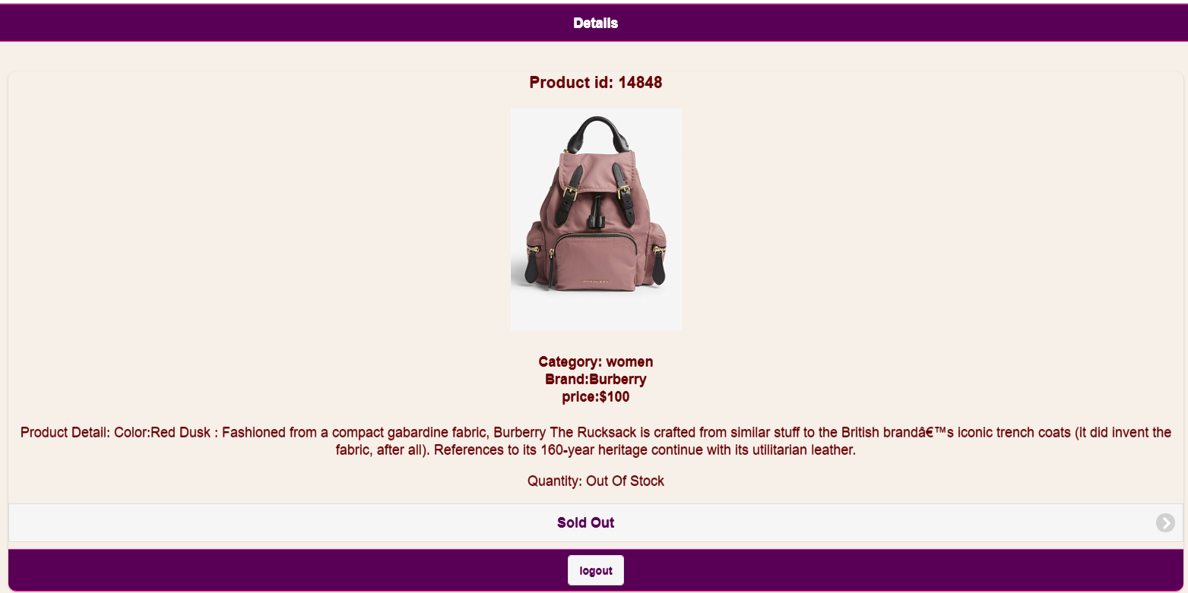
Item not available-Out Of Stock

Slide 21
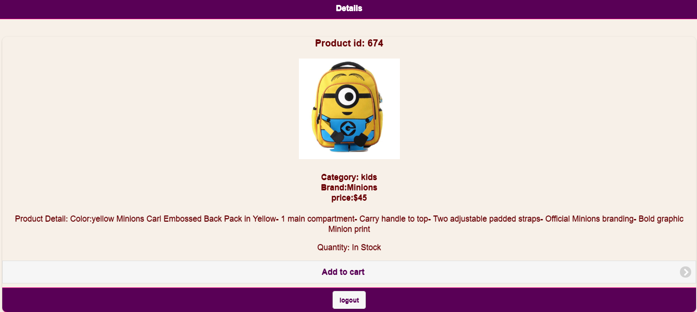
Item available-Add to cart

Slide 22
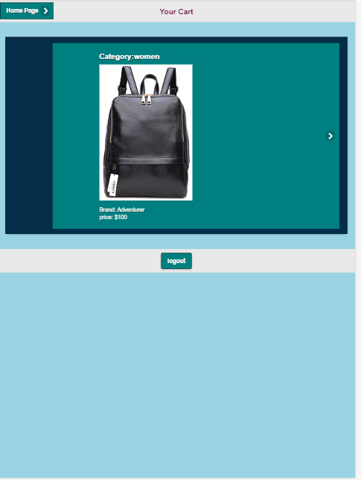

Slide 23
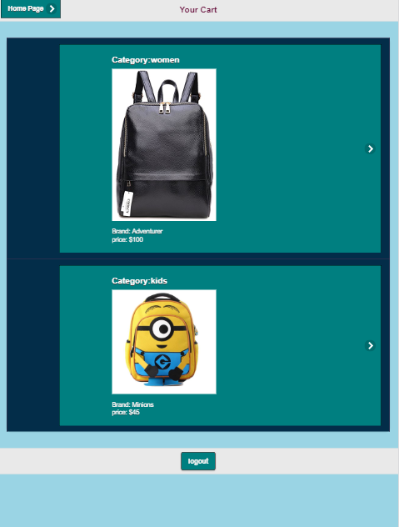
Cart information

Slide 24
Thank you

